Slide 1
Average Tuition Rates US 4-Year Universities
MSDS 6370
Laurie Harris, Tim McWilliams
April 4, 2018

Slide 2
Data Description
Data was gathered from the US Office of Post-Secondary Education
Source: https://catalog.data.gov/dataset/college-affordability-and-transparency-list-explanation-form-201617
2014-2015 Average Tuition Rates for all post-secondary institutions
Less than 2-year, 2-year, and 4-year
Public, private for profit and private not for profit
This review was limited to 4-year universities, including 4-year public, 4-year private not for profit, and 4-year private for profit which included 2640 records.

Slide 3
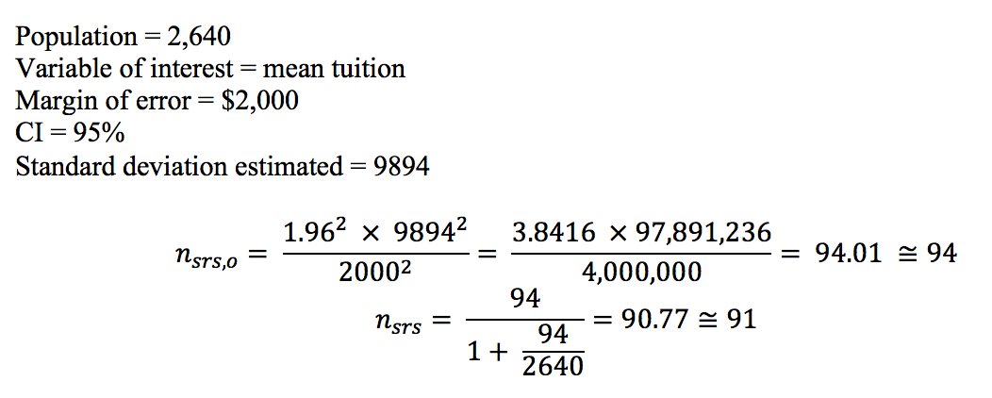
Sampling Approach #1: Simple Random Sample
Sample Size Determination
Sample size of 91
*Standard Deviation was estimated using data from a prior year study. For 2010-2011, standard deviation for 4 year universities was 9,894.

Slide 4
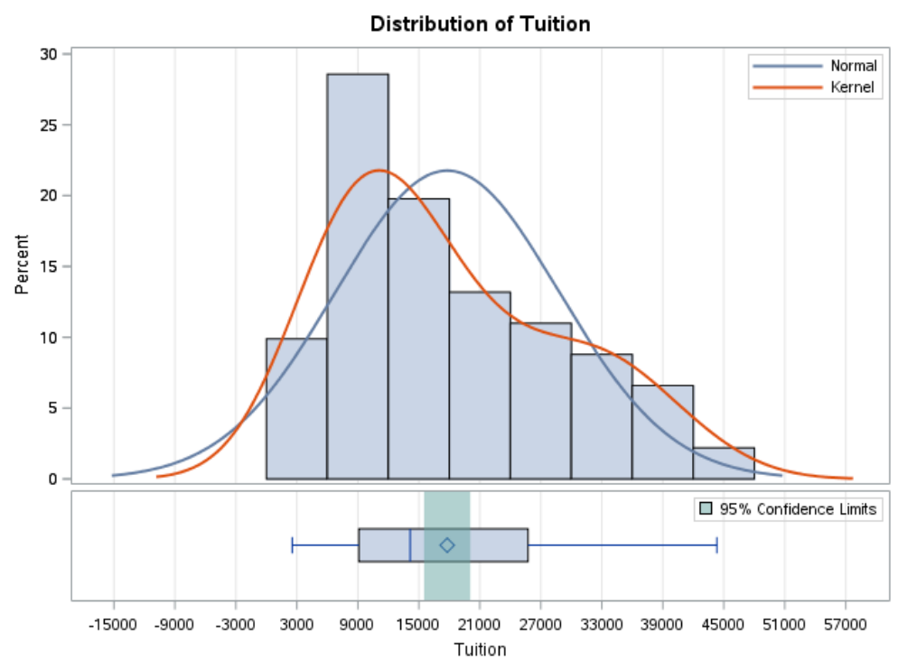
SRS Result
Mean = $17,786
Standard Deviation = $1,139.11
95% Confidence Interval = [$15,523.27, $20,049.44]
We are 95% confident that the true mean falls within the above interval.

Slide 5
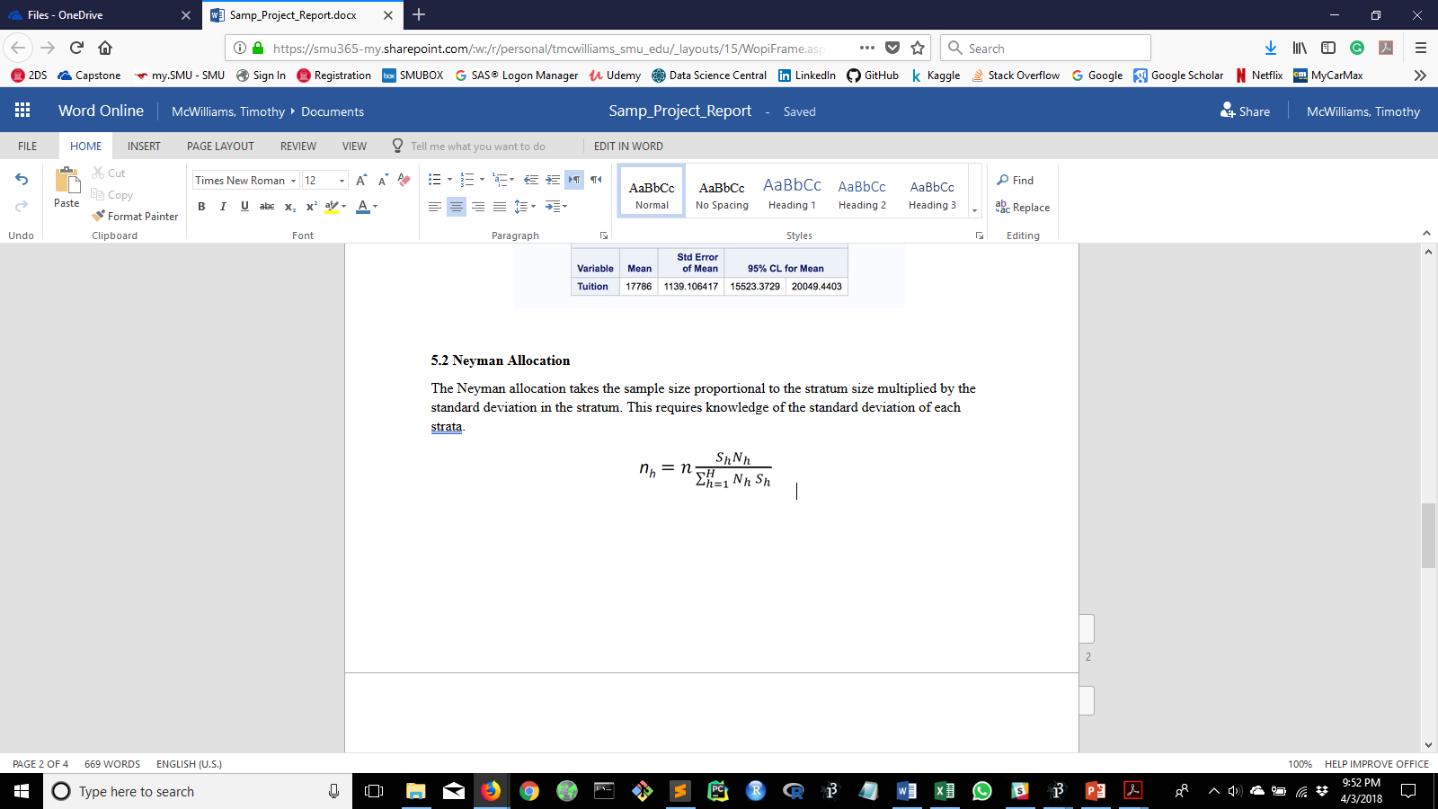
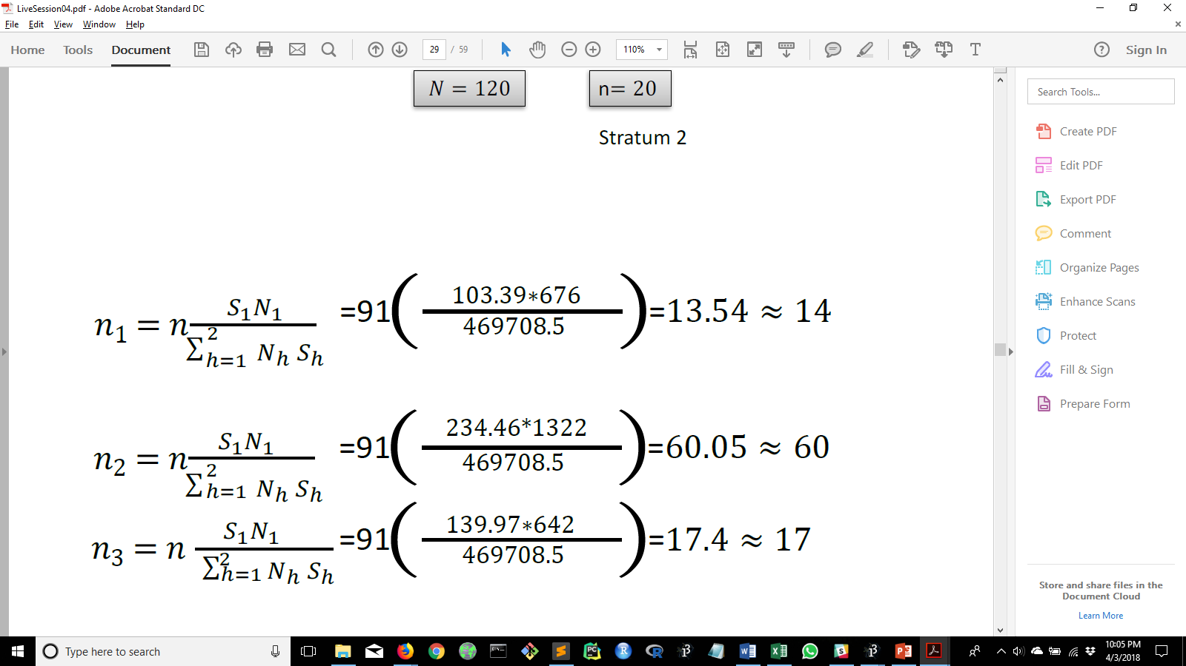
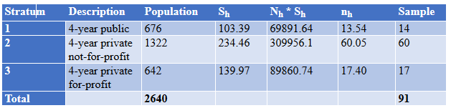
Sampling Approach #2: stratification with Neyman allocation
Sample size proportional to the stratum size multiplied by the standard deviation in the stratum
This requires knowledge of the standard deviation of each strata
Used SAS to calculate standard deviation for each strata

Slide 6
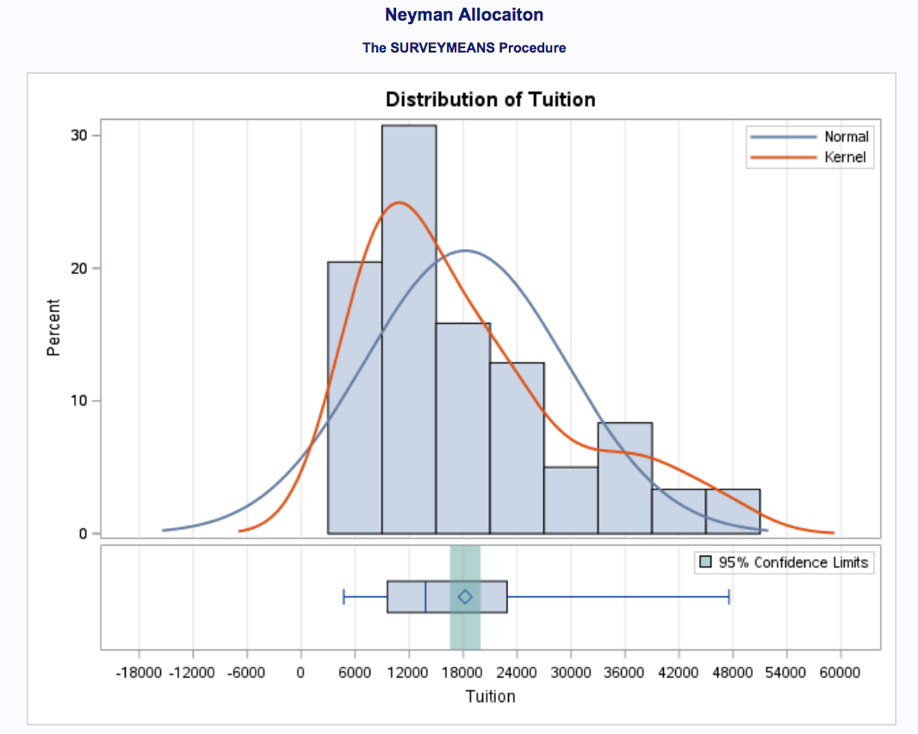
Stratification Result
Mean = $18,230
Standard Deviation = $857.97
95% Confidence Interval = [$16,524.88, $19,934.95]
We are 95% confident that the true mean falls within the above interval.

Slide 7
Comparison
SRS
Mean = $17,786
Standard Deviation = $1,139.11
95% Confidence Interval
[$15,523.27, $20,049.44]
Stratification with Neyman Allocation
Mean = $18,230
Standard Deviation = $857.97
95% Confidence Interval
[$16,524.88, $19,934.95]
The stratification sampling procedure provides a more precise confidence interval.

Slide 8
Five independent Sample Comparison
The true mean tuition for the 2,640 4-year institutions is $18,257
SRS: Simple Random Sample
Stratification with Neyman Allocation
 | 95% Confidence Interval | True Mean Within CI
1 | [$16,399, $21,178] | ✅
2 | [$15,593, $20,177] | ✅
3 | [$18,202, $22,799] | ✅
4 | [$15,751, $20,822] | ✅
5 | [$15,576, $20,361] | ✅
 | 95% Confidence Interval | True Mean Within CI
1 | [$15,889, $18,988] | ✅
2 | [$15,706, $19,146] | ✅
3 | [$17,104, $20,638] | ✅
4 | [$16,350, $19,652] | ✅
5 | [$16,384, $19,849] | ✅

